Slide 1
Detecting AI-Generated Arabic Text Using a Hybrid Approach Integrating Stylistic Features and Deep Semantic Embeddings
BY: Sami Almoadawi

Slide 2

The Problem:
The rapid rise of Large Language Models (LLMs) like GPT, Llama, and Jais has made it difficult to distinguish between human and machine-generated text .
This creates challenges for academic integrity and content verification.
The Objective:
Develop a machine learning pipeline to classify Arabic abstracts into two categories:
Human-Written
AI-Generated
Utilize a combination of linguistic style (Stylometry) and semantic density (BERT embeddings).
Problem & Objective
(Al Minshidawi & Vahabie, 2025)
02

Slide 3
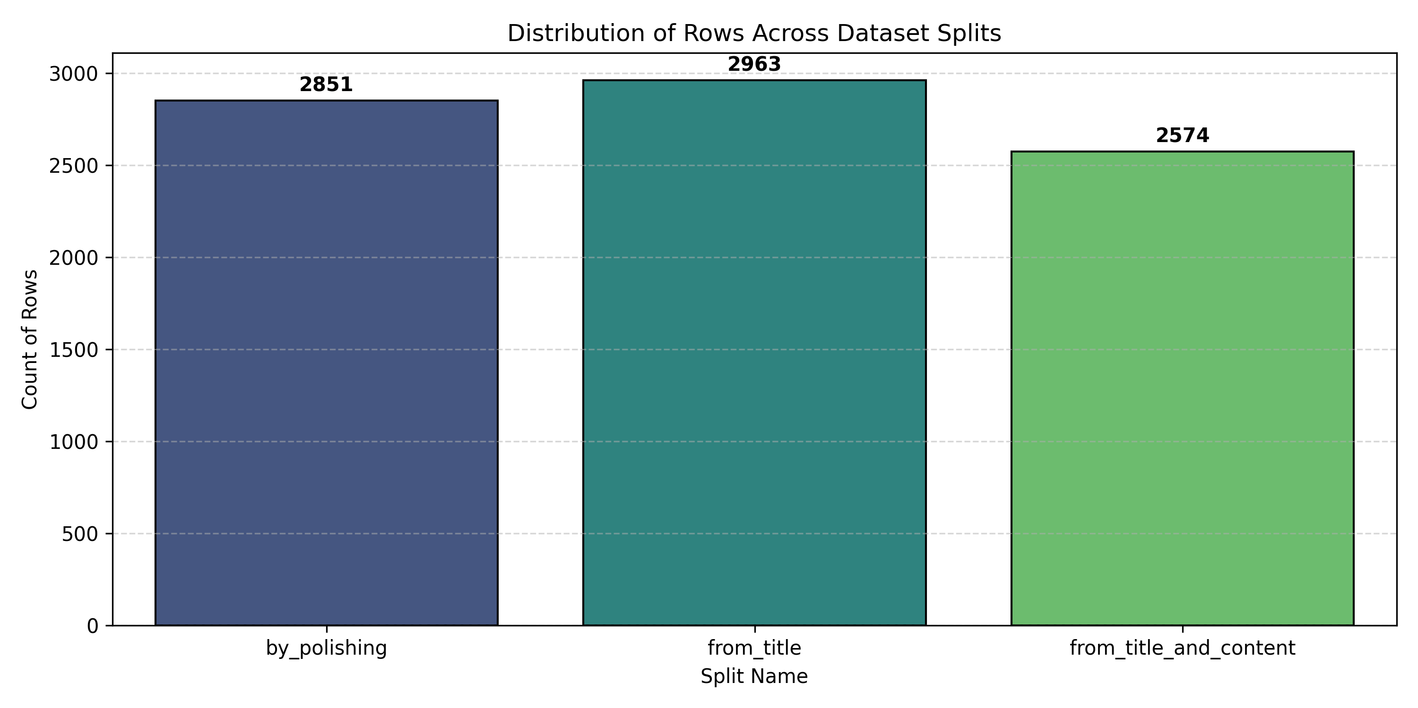
Phase 1 - Data Acquisition & Overview
Dataset Source: KFUPM-JRCAI/arabic-generated-abstracts.
Structure:
Classes: 1 Human class vs. 4 AI classes.
Data Imbalance: AI samples are approximately 4x the number of Human samples.
Data Splits Used:
by_polishing (AI polished human text)
from_title (AI generated from title)
from_title_and_content (AI generated from mixed input).
(Almutairi et al., 2025)
03

Slide 4
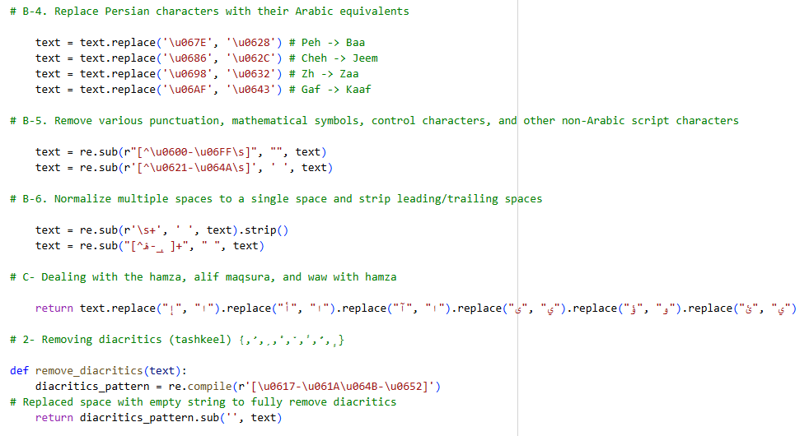
Phase 2 - Data Preprocessing
Goal: Standardize Arabic text to reduce noise and improve model accuracy. Pipeline Steps:
Normalization: Unifying Alef forms(أ, إ, آ -> ا) removing Tatweel (Kashida), and normalizing whitespace.
Cleaning: Removing diacritics (Tashkeel) and non-Arabic symbols.
Stopwords Removal: Filtering out common function words using NLTK.
Stemming: Reducing words to their roots using the ISRI Stemmer.
(Elfaik & Nfaoui, 2020)
04

Slide 5
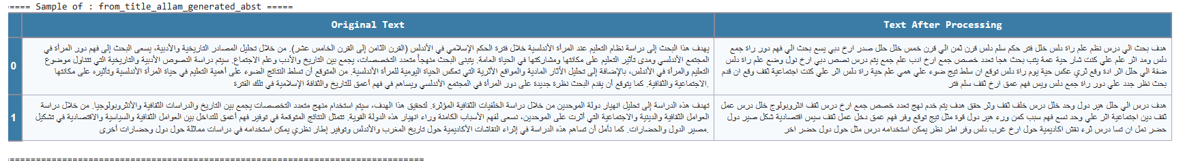
Phase 3 - Feature Engineering (The Core Innovation)
Approach: We engineered specific features to capture the "style" of AI vs. Humans.
Stylometric Features:
Feature 6 (Elongation): Repeated characters (e.g.," جميييل " ("جديييد“.
Feature 29 (Semicolons): Frequency of the Arabic semicolon (؛) usage.
Feature 52 (Interjections): Use of emotional/exclamatory words (e.g.,"يالله", اوه", "واه", "وي", "واسفي", "واحزناه").
Feature 75 (Active Voice): Estimating sentence structure complexity.
Deep Learning Feature:
Feature 98 (BERT CLS L2-Norm): Using AraBERT to calculate the semantic density of the text embeddings.
(Kabir et al., 2024)
05

Slide 6
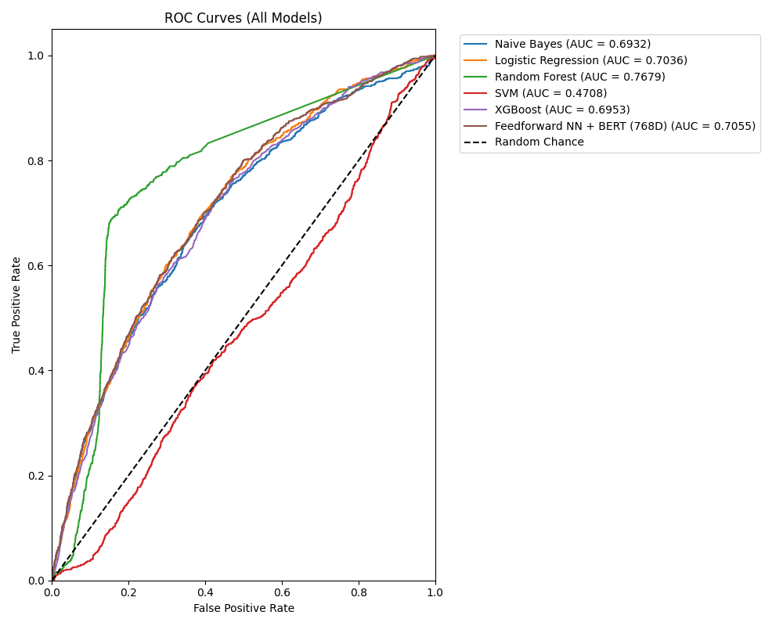
Phase 4 - Modeling Strategy
Data Splitting:
70% Training.
15% Validation.
15% Testing.
Models Trained:
Traditional ML: Naive Bayes, Logistic Regression, Random Forest, SVM, XGBoost .
Deep Learning: Feedforward Neural Network (FFNN) with Batch Normalization and Dropout.
Selection Metric:
A custom weighted average over global metrics.
Macro F1‑Score (average F1 over both classes).
A comprehensive average over six key measures (Accuracy, ROC‑AUC, Macro F1, AI F1, Human F1, and Human Recall).
(Li et al., 2001)
06

Slide 7
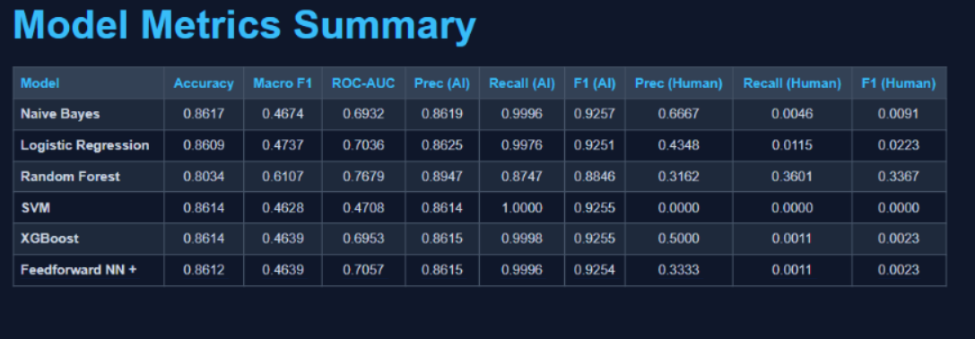
Phase 4 - Classification Models
Logistic Regression - Baseline linear model.
Random Forest - Ensemble of decision trees.
Gradient Boosting - Iterative tree enhancement.
Support Vector Machine (SVM) - Optimal hyperplane separator.
Naive Bayes - Simple probabilistic classifier that assumes that features are conditionally independent.
Neural Network - Multi-layer deep learning model
(Li et al., 2001)
07

Slide 8
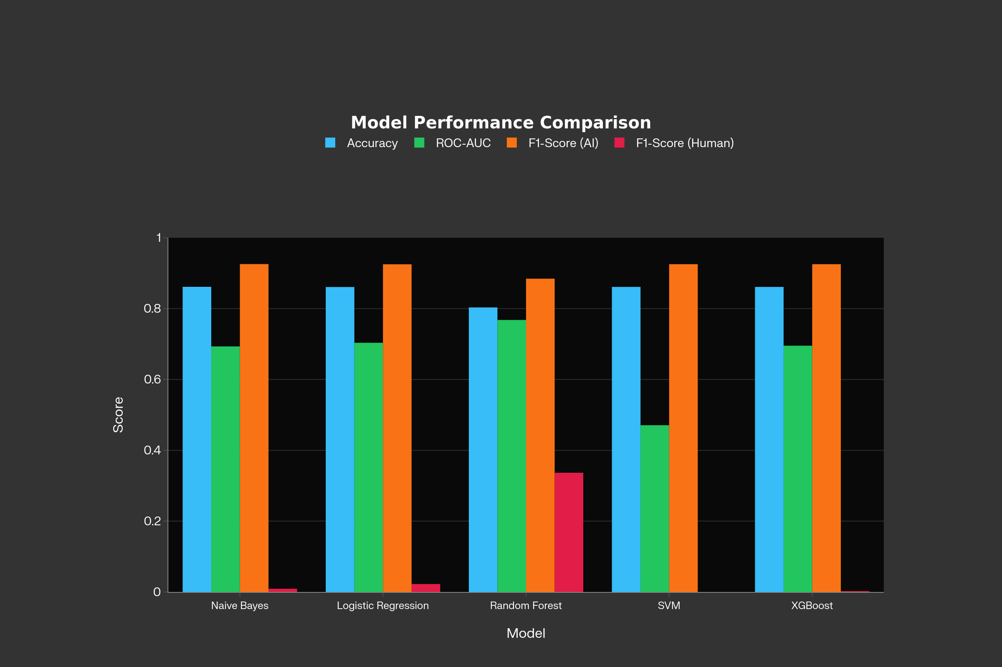
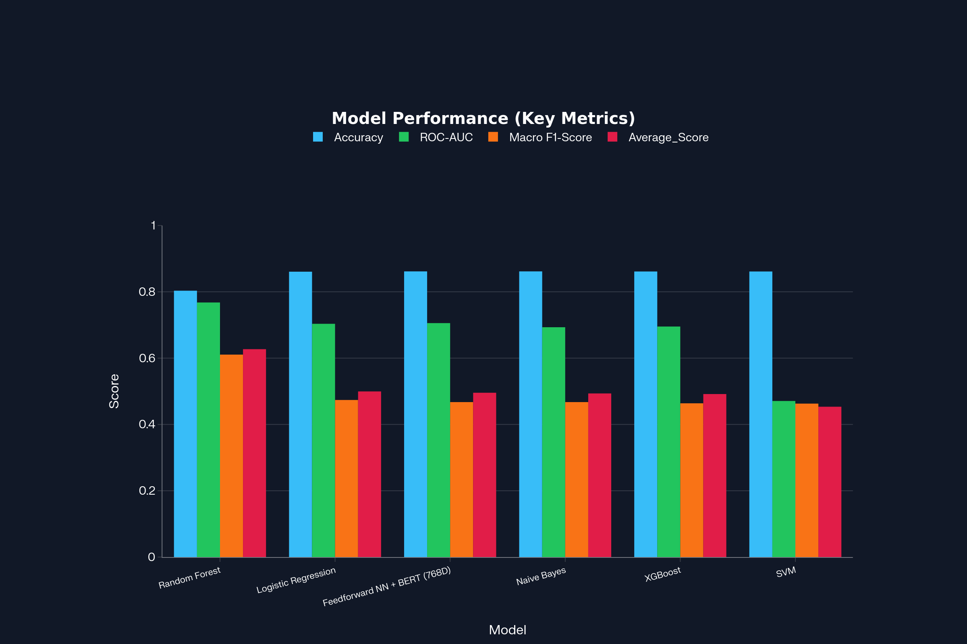
Phase 4 - Modeling Strategy
(Chen et al., 2020)
08

Slide 9
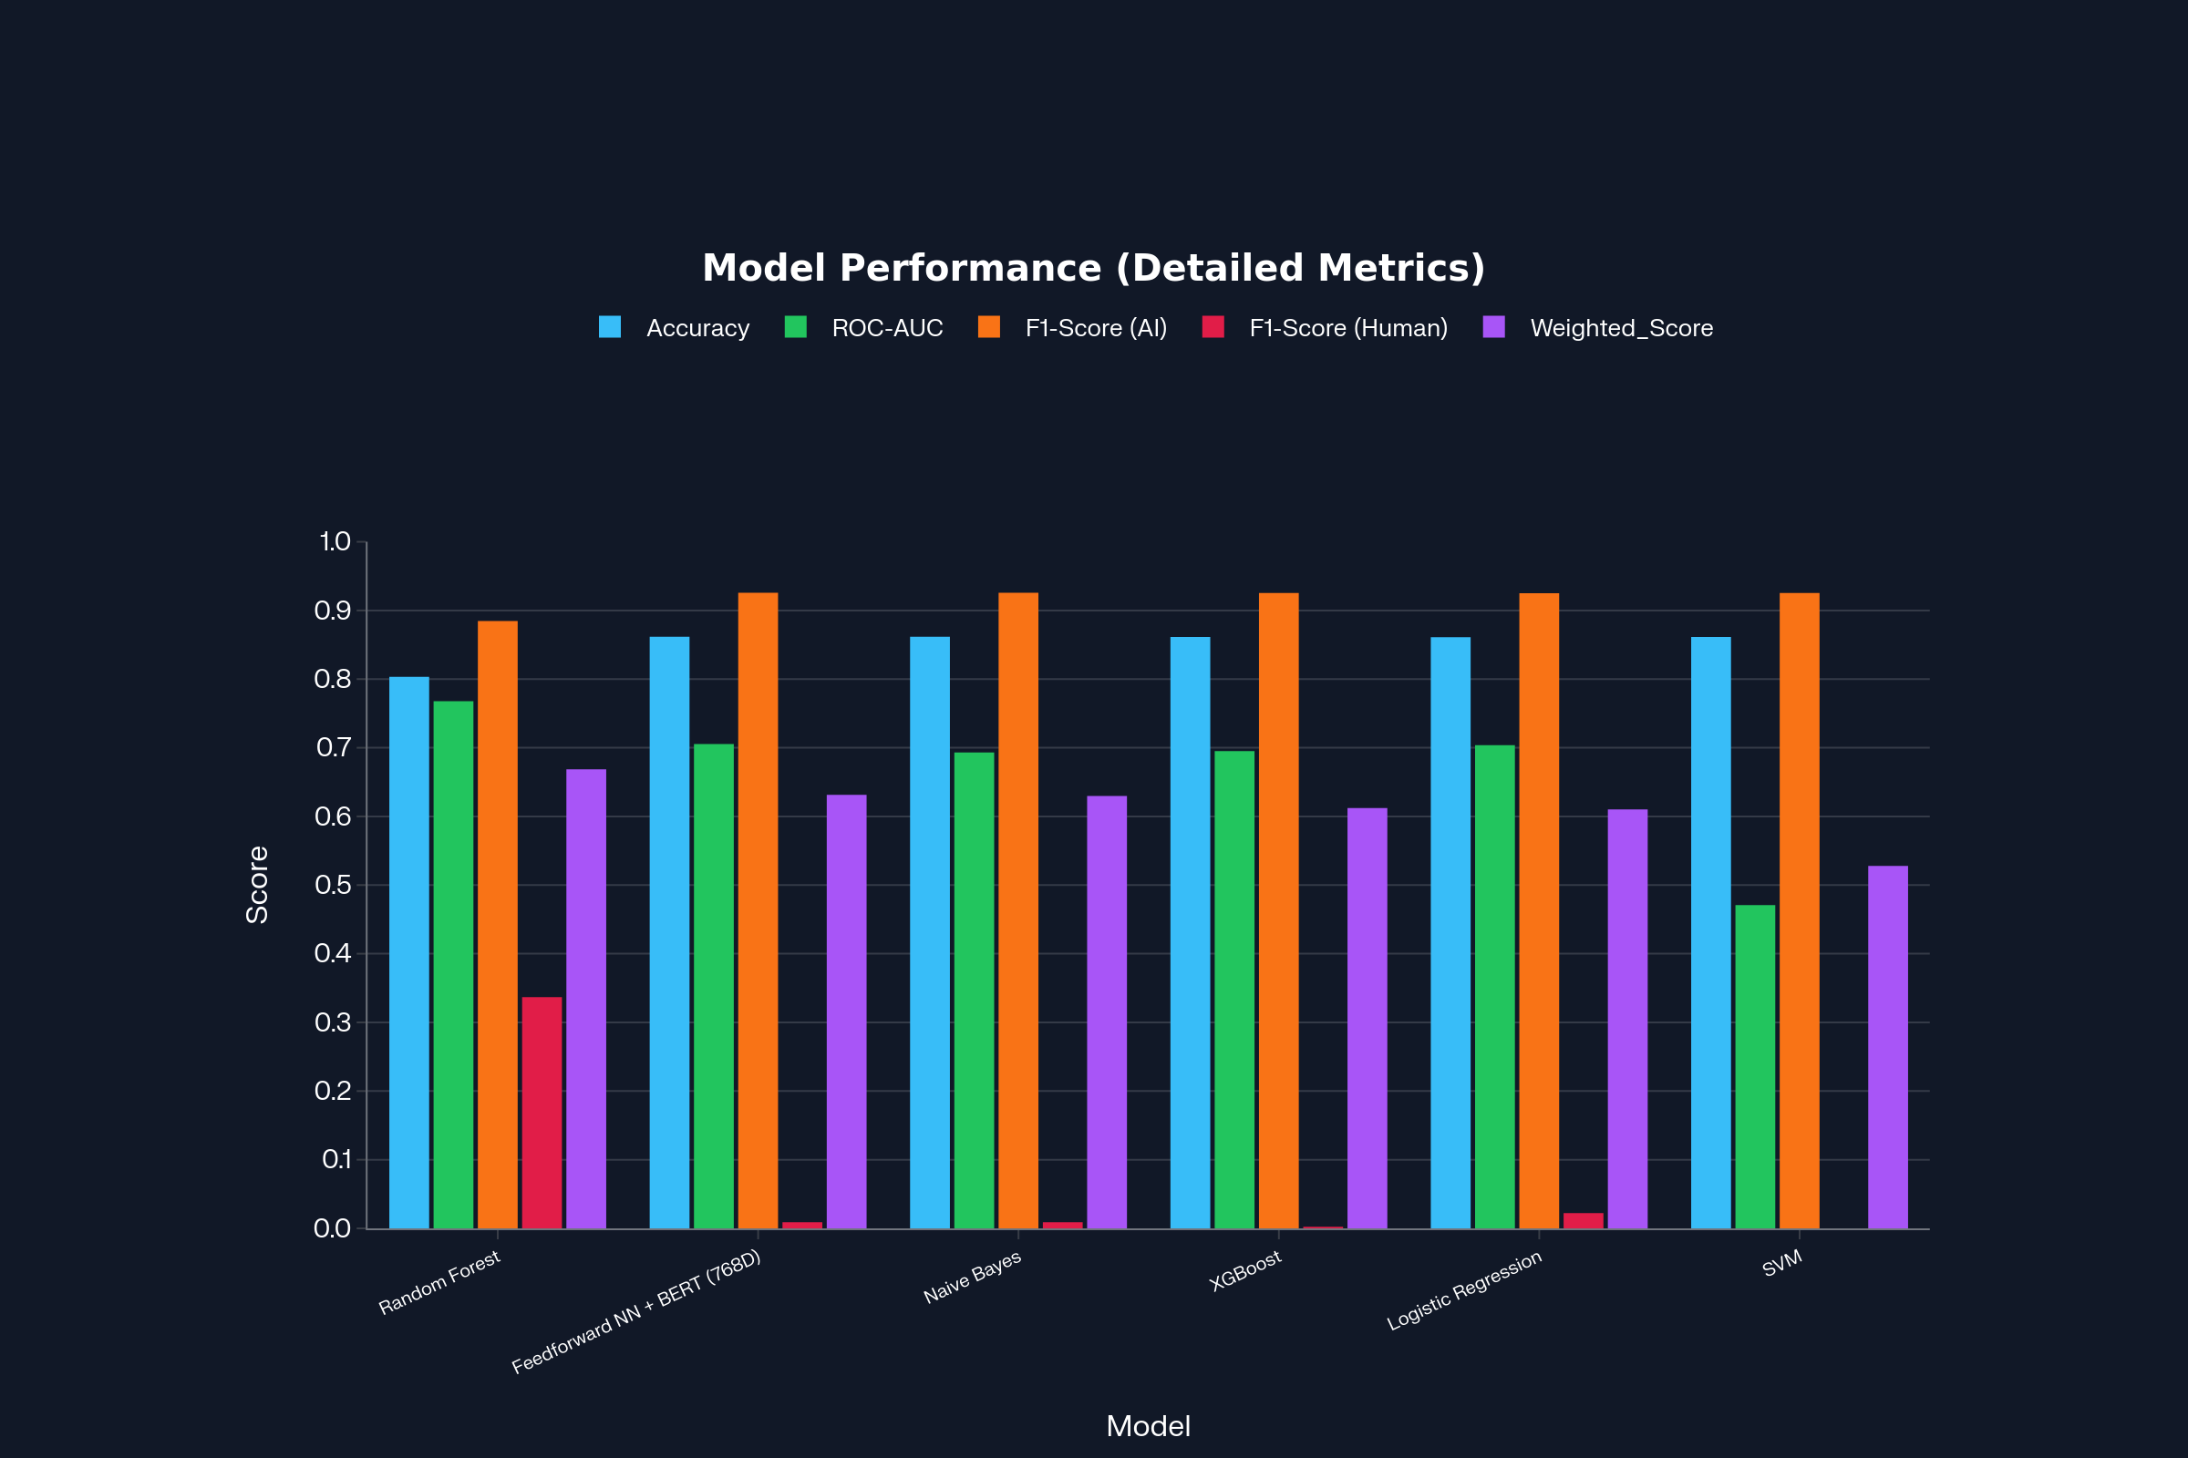
Phase 4 - Modeling Strategy
(Labib et al., 2025)
09

Slide 10
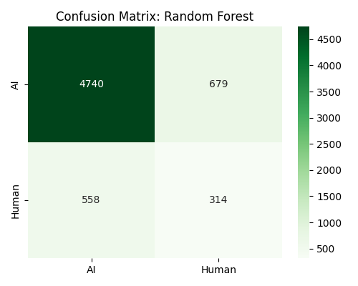
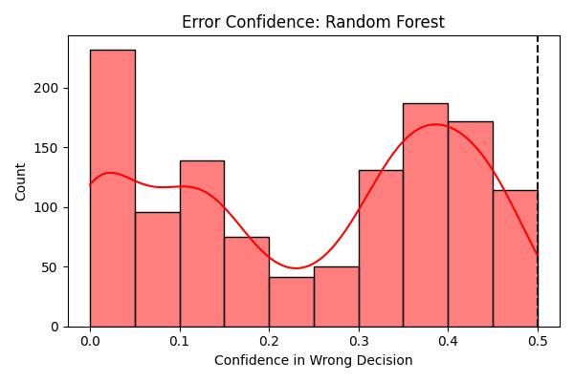
Results & Evaluation
Best Model
Random Forest
Macro F1-Score
0.91
Accuracy
92%
(Salman et al., 2024)
10

Slide 11
Limitations
Noisy active-voice feature due to diacritic stripping.
Single CLS representation may miss token-level nuance.
Single train/validation/test split (no cross-validation).
Single dataset (KFUPM‑JRCAI) limits generalizability.
(Almutairi et al., 2025)
11

Slide 12

CONCLUSION
Stylometric Features (such as character elongation and semicolon usage) proved to be powerful discriminators, highlighting the difference between human "writing style" and AI "statistical generation".
Random Forest balances detection performance with lower misclassification risk for human texts.
The integration of these engineered features with BERT L2-Norm resulted in a robust model, selected based on the Macro F1-Score to ensure balanced detection of both Human and AI classes.
Future Work: Expand the dataset to include newer models (e.g., GPT-4o) and explore Transformer-based fine-tuning.
12

Slide 13

“Any Questions?”
13

Slide 14
References
Al Minshidawi, O., & Vahabie, A. H. (2025). Classifying AI-Generated Text in Low-Resource Languages like Arabic. AUT Journal of Modeling and Simulation, 57(1), 113-124.
Almutairi, N., Alghamdi, M., & Alshammari, A. (2025). The Arabic AI fingerprint: Stylometric analysis and detection of machine‑generated text. SDAIA‑KFUPM Joint Research Center for Artificial Intelligence. KFUPM‑JRCAI. (2025). Arabic‑generated‑abstracts. Hugging Face.
Chen, J., Zhao, F., Sun, Y., & Yin, Y. (2020). Improved XGBoost model based on genetic algorithm. International Journal of Computer Applications in Technology, 62(3), 240. https://doi.org/10.1504/ijcat.2020.106571
Elfaik, H., & Nfaoui, E. H. (2020). Deep bidirectional LSTM Network Learning-Based Sentiment Analysis for Arabic text. Journal of Intelligent Systems, 30(1), 395–412. https://doi.org/10.1515/jisys-2020-0021
Labib, M., Ashraf, N., Aldawsari, M., & Nayel, H. (2025, November). REGLAT at AraGenEval Shared Task: Morphology-Aware AraBERT for Detecting Arabic AI-Generated Text. In Proceedings of The Third Arabic Natural Language Processing Conference: Shared Tasks (pp. 94-98).
Li, W., Han, J., & Pei, J. (2001, November). CMAR: Accurate and efficient classification based on multiple class-association rules. In Proceedings 2001 IEEE international conference on data mining (pp. 369-376). IEEE.
Salman, H. A., Kalakech, A., & Steiti, A. (2024). Random Forest algorithm Overview. Babylonian Journal of Machine Learning, 2024, 69–79. https://doi.org/10.58496/bjml/2024/007
14

